Slide 1

From Nand to Tetris
Building a Modern Computer from First Principles
Chapter 5
Computer Architecture
These slides support chapter 5 of the book
The Elements of Computing Systems
(1st and 2nd editions)
By Noam Nisan and Shimon Schocken
MIT Press

Slide 2
Usage Notice
You are welcome to use this presentation, or any part of it, in Nand to Tetris courses, or in other courses, as you see fit.
Usage is free provided that it supports instruction in educational, non-profit settings.
You can use the slides as-is, or modify them as needed.
We’ll appreciate it if you will credit Nand to Tetris somewhere, and put a reference to www.nand2tetris.org
Happy teaching!
Shimon Schocken / Noam Nisan

Slide 3
Nand to Tetris Roadmap (Part I: Hardware)
abstraction
machine language
Developing an assembler
hardware platform
abstraction
Building a computer
computer
abstraction
Building chips
ALU, RAM
abstraction
Building gates
elementary logic gates
Nand

Slide 4
Nand to Tetris Roadmap (Part I: Hardware)
abstraction
Previous chapter:
Low-level programming
Assembly language
Hack computer overview
p4
Writing low-level programs
machine language
Developing an assembler
hardware platform
abstraction
Building a computer
computer
abstraction
Building chips
ALU, RAM
abstraction
Building gates
p2
elementary logic gates
Nand
p3
p1

Slide 5
Nand to Tetris Roadmap (Part I: Hardware)
abstraction
This chapter: Integrate the chips built in chapters 1,2,3 into a computer architecture capable of executing programs written in the machine language introduced in chapter 4
p4
Writing low-level programs
machine language
Developing an assembler
hardware platform
abstraction
Building a computer
computer
abstraction
Building chips
p5
ALU, RAM
abstraction
Building gates
p2
elementary logic gates
Nand
p3
p1

Slide 6
Nand to Tetris Roadmap (Part I: Hardware)
This chapter: Integrate the chips built in chapters 1,2,3 into a computer architecture capable of executing programs written in the machine language introduced in chapter 4
f
Machine language program (example)
x
// Computes R1 = 1 + 2 + 3 + ... + R0
// i = 1
@i
M=1
// sum = 0
@sum
M=0
(LOOP)
// if (i > R0) goto STOP
@i
D=M
@R0
D=D-M
@STOP
D;JGT
...
16
16
ALU
out
RAM
16
16
14
y
16
PC
Register
16
16
16
16

Slide 7
Computer architecture
Memory
CPU
program
data register
data register
•
input
•
output
data
•
ALU
data register
address register
PC
Typical computer architecture:
Stored program concept
General-purpose
In this chapter we build the Hack computer – a variant of this architecture.

Slide 8
Chapter 5: Computer Architecture
Basic architecture
Fetch-Execute cycle
The Hack CPU
Input / output
Memory
Computer
Project 5: Chips
Project 5: Guidelines

Slide 9
Chapter 5: Computer Architecture
Basic architecture
Fetch-Execute cycle
The Hack CPU
Input / output
Memory
Computer
Project 5: Chips
Project 5: Guidelines

Slide 10


Early computers (17th century)
Blaise Pascal 1623-1662
Pascal’s Calculator
(Pascaline, 1652)
Add
Subtract

Slide 11
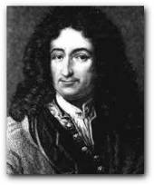
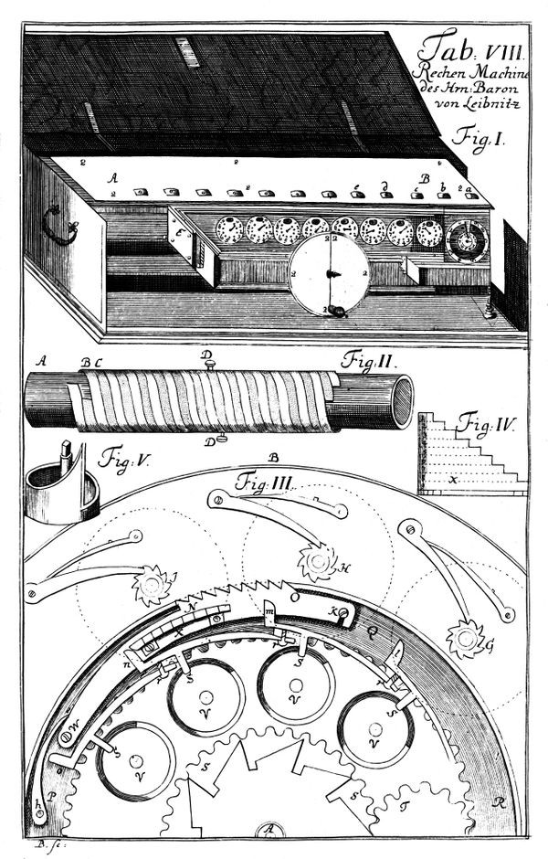
Early computers (17th century)
Gottfried Leibniz 1646-1716
Leibniz Calculator (1673)
Add
Subtract
Multiply
Divide.

Slide 12
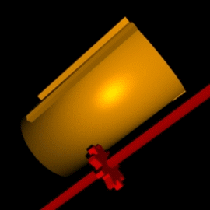
Early computers (17th century)
Gottfried Leibniz 1646-1716
Leibniz Calculator (1673)
Add
Subtract
Multiply
Divide.
Side benefits: Advances in gears / mechanical engineering

Slide 13
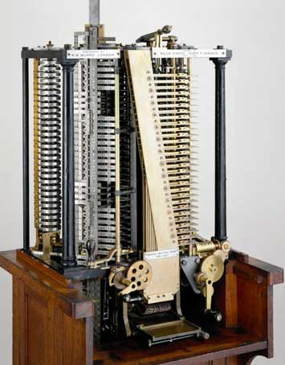
Early computers (19th century)
Major innovation:
Punched cards = software
Jacquard Loom (1804)
Analytic Engine (1837)

Slide 14
Early computers
17th century: Hardware only / fixed / single purpose
Programmable!
19th century: Hardware / Software / General purpose

Slide 15

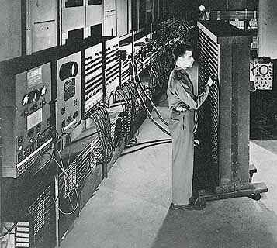
Modern computers (20th century)
John Von Neumann
ENIAC: First digital, programmable, stored program computer
University of Pennsylvania, 1946,
(Borrowed key ideas from other early computers and innovators)

Slide 16
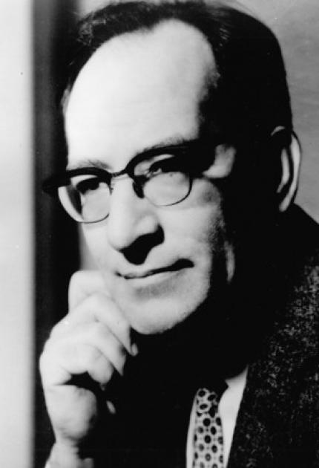
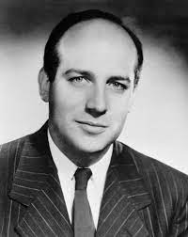
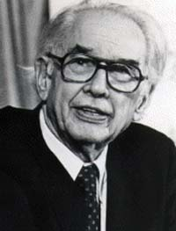
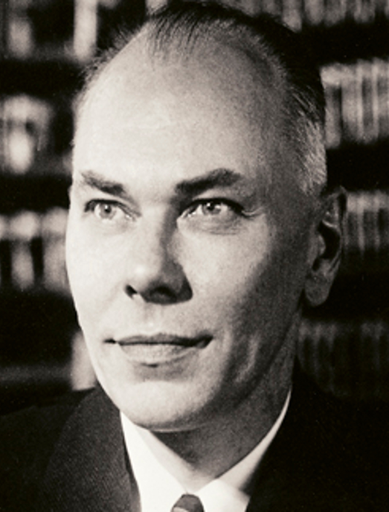
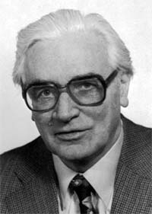
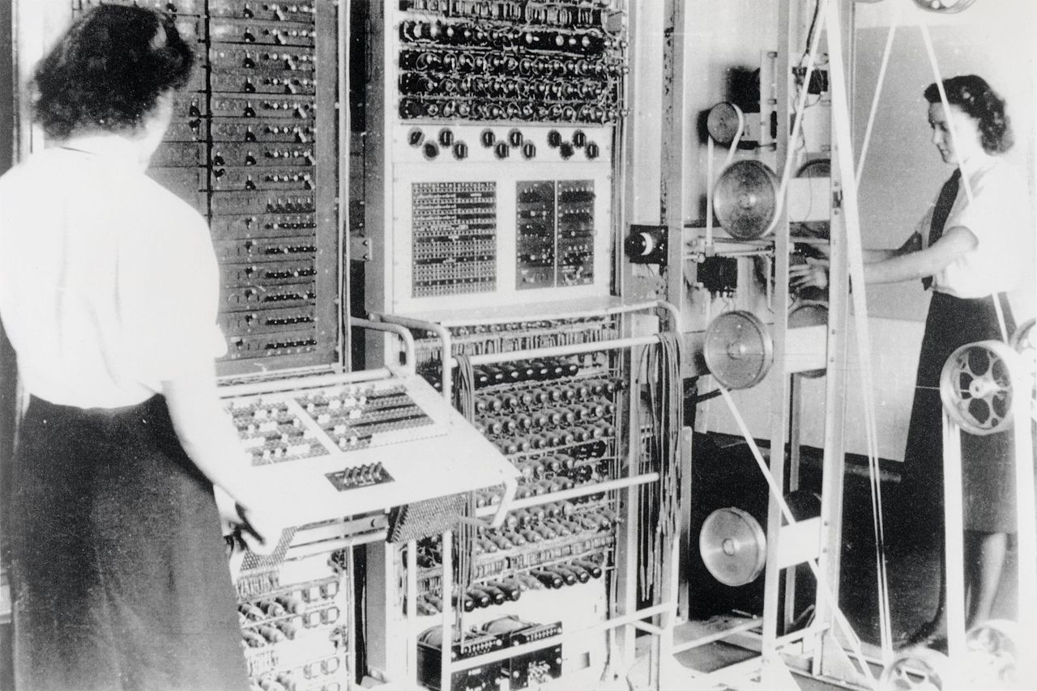
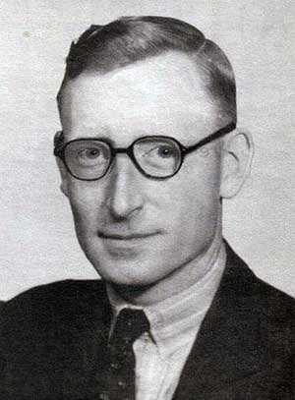
Modern computers (20th century)
John Mauchly
Presper Eckert
John Von Neumann
John Atanassof
Howard Aiken
Konrad Zuse
ENIAC: First digital, programmable, stored program computer
University of Pennsylvania, 1946,
(Borrowed key ideas from other early computers and innovators)
Tommy Flowers
Colossus: First digital, programmable, computer, UK, 1945

Slide 17
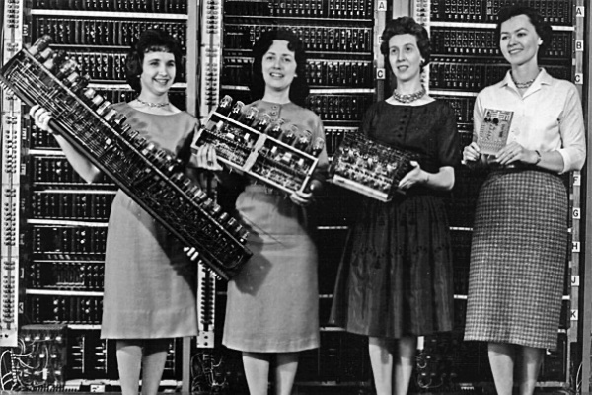
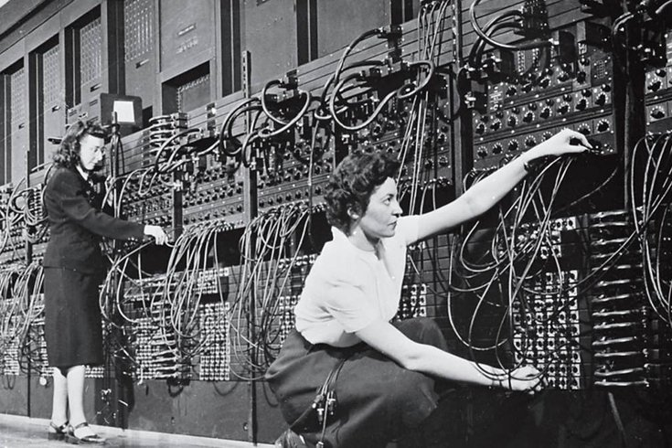

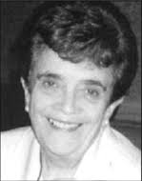
Modern computers (20th century)
ENIAC Women
Pioneered reusable code, subroutines, flowcharts, and many other programming innovations
Kathleen McNulty, Jean Jennings, Frances Snyder, Marlyn Wescoff, Frances Bilas, Ruth Lichterman
Compilation pioneers
(Mark I)
Grace Hopper
Adele Koss

Slide 18

Modern computers (20th century)
Same hardware can run many different programs (software)
Back in the 1950’s, this was considered a radical idea:
“If it should turn out that the basic logic of a machine designed for the numerical solution of differential equations coincides with the logic of a machine intended to make bills for department stores, I would regard this as the most amazing coincidence I have ever encountered” –– Howard Aiken, 1956 (Mark 1 computer architect)

Slide 19
Basic architecture
Memory
CPU
program
register
register
input
output
data
•
ALU
•
•
register
Stored program concept:
Same machine can run different programs
“The stored program computer, as conceived by Alan Turing and delivered by John von Neumann, broke the distinction between numbers that mean things and numbers that do things. Our universe would never be the same”. (George Dyson)

Slide 20
Basic architecture
Memory
CPU
program
data register
data register
•
•
data
•
ALU
data register
address register
PC
The computer is essentially a machine that manipulates registers under program control: data registers, address registers, a program counter (PC), memory registers (containing data and instructions).
How does information flow inside the computer?

Slide 21
Basic architecture
Memory
CPU
program
data register
data register
•
•
data
•
ALU
data register
address register
PC
instructions
control bus

Slide 22
Basic architecture
Memory
CPU
program
data register
data register
•
•
data
•
ALU
data register
address register
PC
instructions
control bus
addresses
address bus

Slide 23
Basic architecture
Memory
CPU
program
data register
data register
•
•
•
ALU
data
ALU
data register
address register
PC
instructions
control bus
addresses
address bus
data values
data bus

Slide 24
Basic architecture: Recap
Memory
CPU
program
data register
data register
•
•
data
•
ALU
data register
address register
PC
General purpose computer
A set of chips connected by buses
Stored program concept
Framework of most modern computers

Slide 25

Chapter 5: Computer Architecture
Basic architecture
Fetch-Execute cycle
The Hack CPU
Input / output
Memory
Computer
Project 5: Chips
Project 5: Guidelines

Slide 26
Computer architecture
Memory
CPU
Basic loop:
Fetch an instruction (by supplying an address)
Execute the instruction
(And… figure out the address of the next instruction)
program
data register
data register
•
•
data
•
ALU
data register
address register
PC

Slide 27
Computer architecture
Memory
CPU
Basic loop:
Fetch an instruction (by supplying an address)
Execute the instruction
(And… figure out the address of the next instruction)
program
data register
data register
•
•
data
•
ALU
data register
address register
PC
Program Counter: Always emits the address of the next instruction

Slide 28
Fetch an instruction
Memory
CPU
Basic loop:
Fetch an instruction (by supplying an address)
Execute the instruction
(And… figure out the address of the next instruction)
program
data register
data register
•
•
data
•
ALU
data register
address register
PC
Program Counter: Always emits the address of the next instruction
address
instruction
address
address bus

Slide 29
Fetch an instruction
Memory
CPU
Basic loop:
Fetch an instruction (by supplying an address)
Execute the instruction
(And… figure out the address of the next instruction)
program
data register
data register
•
•
data
•
ALU
data register
address register
PC
instruction
instruction
control bus

Slide 30
Execute the instruction
Memory
CPU
Basic loop:
Fetch an instruction (by supplying an address)
Execute the instruction
(And… figure out the address of the next instruction)
program
data register
data register
•
•
data
•
ALU
data register
address register
PC
instruction
instruction
control bus
The instruction bits specify:
Which operation to execute
Which address in memory the operation should act on

Slide 31
Fetch – execute issues
Memory
Should the single Memory output be interpreted as data, or as instruction?
program
instruction
out
ALU
data
data
(for the instruc. to operates on)
Possible solutions:
Two-cycle machine
One-cycle, two-memory machine
address
instruc. address
data
address
Which of the two addresses to feed into the Memory’s single address input?
control bus
address bus

Slide 32
Two-cycle machine
Memory
program
instruction
out
ALU
data
data
(for the instruc. to operates on)
address
instruc. address
data
address
control bus
address bus

Slide 33
Two-cycle machine
Memory
program
when fetching
instruction register
instruction
out
DMux
ALU
data
data
when executing
(for the instruc. to operates on)
address
Mux
(when fetching)
instruc. address
data
address
(when executing)
control bus
address bus

Slide 34
Two-cycle machine
Memory
program
when fetching
instruction register
instruction
out
DMux
ALU
data
data
when executing
(for the instruc. to operates on)
Fetch cycle: Loads an instruction into the instruction register
Execute cycle: Loads a data value from memory, and executes the instruction
fetch / execute bit
address
Mux
(when fetching)
instruc. address
data
address
(when executing)
control bus
address bus

Slide 35
Single cycle, two-memory machine
Instruction Memory
CPU
Data Memory
program
data
data register
instruc-
tion
data register
write
•
•
•
ALU
read
data register
address
address
address register
PC
Program and data are stored in two separate physical memories
Both memories are accessed simultaneously, in the same cycle
(Sometimes called ”Harvard architecture”)

Slide 36
Single cycle, two-memory machine
Instruction Memory
CPU
Data Memory
program
data
data register
instruc-
tion
data register
write
•
•
•
ALU
read
data register
address
address
address register
PC
Advantages
Simpler architecture
Faster processing
Disadvantages
Two memory chips
Separate address spaces

Slide 37
Chapter 5: Computer Architecture
Basic architecture
Fetch-Execute cycle
The Hack CPU
Input / output
Memory
Computer
Project 5: Chips
Project 5: Guidelines

Slide 38


Hack computer
Instruction Memory
CPU
Data Memory
program
data
instruc-
tion
D register
write
Hello, world
A register
ALU
read
address
address
PC
Single cycle computer
Two separate memory units

Slide 39
Hack computer
Instruction Memory
CPU
Data Memory
program
data
instruc-
tion
D register
write
Hello, world
A register
ALU
read
address
address
PC

Slide 40
CPU abstraction
D register
A register
Instruction examples:
CPU Abstraction:
Executes instructions written in the Hack machine language
// D = RAM[5] + 1
@5
D=M+1
…
// RAM[3] = D
@3
M=D
…

Slide 41
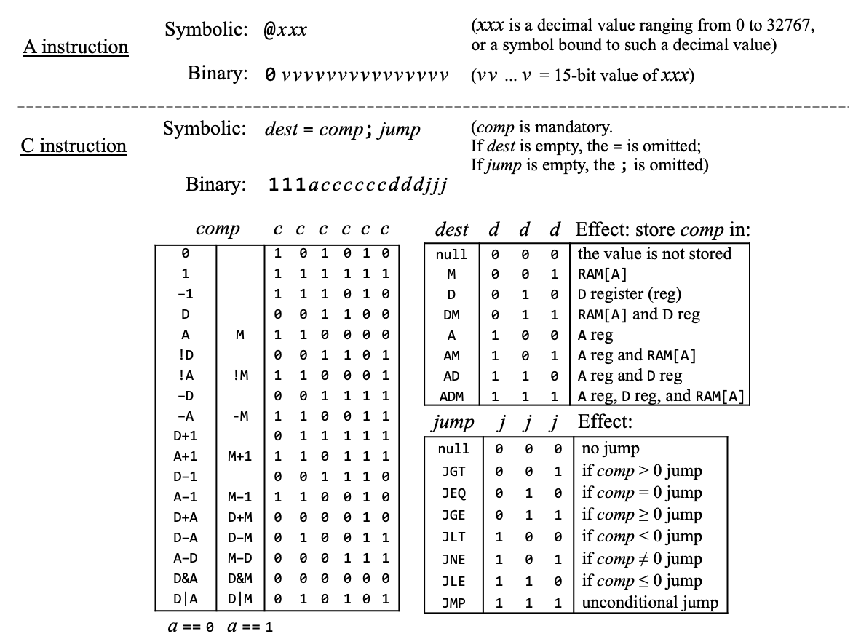
CPU abstraction
Hack instructions (formal specification)

Slide 42
CPU abstraction
D register
A register
Instruction examples:
CPU Abstraction:
Executes instructions written in the Hack machine language
// D = RAM[5] + 1
@5
D=M+1
…
// RAM[3] = D
@3
M=D
…
Note that the selected memory register M can be input, or output, or both input and output (example: M=M+1)

Slide 43
CPU abstraction
Holds the value of M, the selected memory register
D register
A register
Instruction examples:
CPU Abstraction:
Executes instructions written in the Hack machine language
// D = RAM[5] + 1
@5
D=M+1
…
// RAM[3] = D
@3
M=D
…
Note that the selected memory register M can be input, or output, or both input and output (example: M=M+1)

Slide 44
CPU abstraction
Holds the value of M, the selected memory register
Hold the value, write enable bit, and address of M, the selected memory register
D register
A register
Instruction examples:
CPU Abstraction:
Executes instructions written in the Hack machine language
// D = RAM[5] + 1
@5
D=M+1
…
// RAM[3] = D
@3
M=D
…
Note that the selected memory register M can be input, or output, or both input and output (example: M=M+1)

Slide 45
CPU abstraction
Holds the value of M, the selected memory register
Hold the value, write enable bit, and address of M, the selected memory register
D register
A register
We mention these internal chip-parts (D and A) in the CPU abstraction, since Hack instructions refer to them
Instruction examples:
CPU Abstraction:
Executes instructions written in the Hack machine language
// D = RAM[5] + 1
@5
D=M+1
…
// RAM[3] = D
@3
M=D
…
Note that the selected memory register M can be input, or output, or both input and output (example: M=M+1)

Slide 46
CPU abstraction
D register
A register
CPU operation:
1. Executes the instruction:
If it’s an A instruction (@xxx), sets the A register to xxx
Else:
If the instruction uses M as input, gets this value from inM
Computes the ALU function specified by the instruction
If the instruction writes to M, puts the ALU output in outM, puts the register’s address in addressM, and asserts the writeM bit
2. Figures out the address of the next instruction, and puts it in pc.
Instruction examples:
// D = RAM[5] + 1
@5
D=M+1
…
// RAM[3] = D
@3
M=D
…

Slide 47
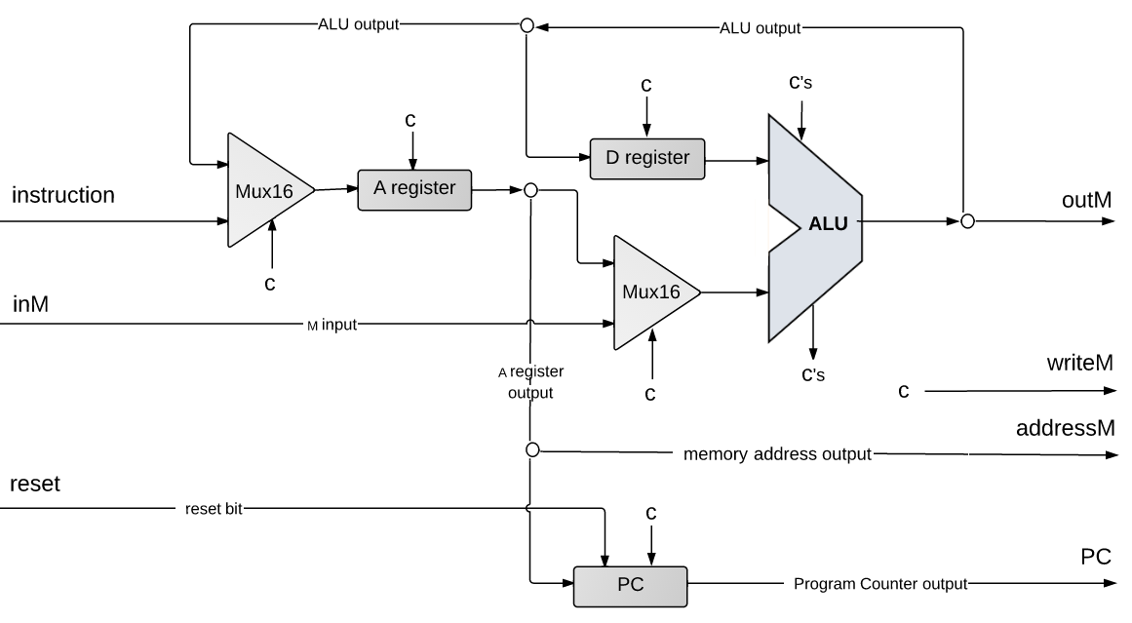
CPU implementation
pc
Notes:
It’s a very lean ALU, consisting of 2 registers, named D and A, a program counter, an ALU, and few more trivial gates.

Slide 48
CPU implementation
In the diagram, “c“ denotes “control bit”;
The control bits come from the instruction;
They tell the various chip-parts what to do.
pc
Notes:
It’s a very lean ALU, consisting of 2 registers, named D and A, a program counter, an ALU, and few more trivial gates.

Slide 49
CPU implementation
pc
Notes:
It’s a very lean ALU, consisting of 2 registers, named D and A, a program counter, an ALU, and few more trivial gates.

Slide 50
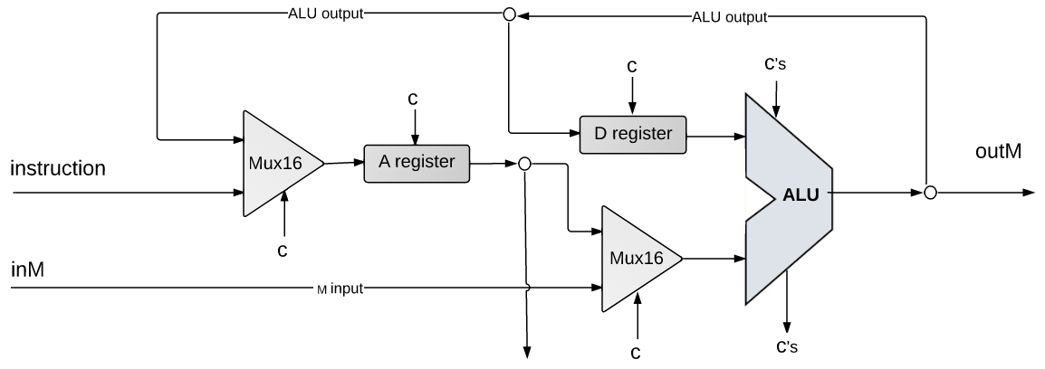
CPU implementation: Instruction handling
outM
@5
0000000000000101
writeM
inM
Handling A-instructions
Routes the instruction’s MSB (op-code) to the Mux16 control bit

Slide 51
CPU implementation: Instruction handling
outM
@5
0000000000000101
0
writeM
inM
Handling A-instructions
Routes the instruction’s MSB (op-code) to the Mux16 control bit

Slide 52
CPU implementation: Instruction handling
outM
@5
0000000000000101
0
writeM
inM
Handling A-instructions
Routes the instruction’s MSB (op-code) to the Mux16 control bit
Result: A-register ← instruction (value)
(Exactly what the @xxx instruction specifies: “set A to xxx”)

Slide 53
CPU implementation: Instruction handling
outM
1110011111010111
D=D+1;JMP
writeM
inM

Slide 54
CPU implementation: Instruction handling
opcode bit
comp bits
dest bits
jump bits
outM
1110011111010111
D=D+1;JMP
writeM
inM
Handling C-instructions
Each instruction field (opcode, comp bits, dest bits, and jump bits) is handled separately
Each group of bits is used to ”tell” a CPU chip-part what to do
Taken together, the chip-parts end up executing the instruction.

Slide 55
CPU implementation: Instruction handling
opcode bit
comp bits
dest bits
jump bits
outM
1110011111010111
D=D+1;JMP
1
writeM
inM
Handling C-instructions (the opcode bit):
Routes the instruction’s MSB to the Mux16
Result: Prepares the A register to get the ALU output.

Slide 56
CPU implementation: Instruction handling
opcode bit
comp bits
dest bits
jump bits
011111
outM
1110011111010111
D=D+1;JMP
writeM
inM
0
Handling C-instructions (the computation bits)
Routes the instruction’s c-bits to the ALU control bits
Routes the instruction’s a-bit to the Mux16
Result: the ALU computes the specified function
which becomes the ALU output

Slide 57
CPU implementation: Instruction handling
opcode bit
comp bits
dest bits
jump bits
outM
1110011111010111
D=D+1;JMP
writeM
inM
ALU output:
Result of ALU calculation

Slide 58
CPU implementation: Instruction handling
opcode bit
comp bits
dest bits
jump bits
outM
1110011111010111
D=D+1;JMP
writeM
inM
ALU output:
Result of ALU calculation
Fed simultaneously to D-register, A-register, data memory

Slide 59
CPU implementation: Instruction handling
opcode bit
comp bits
dest bits
jump bits
outM
1110011111010111
D=D+1;JMP
writeM
inM
ALU output:
Result of ALU calculation
Fed simultaneously to D-register, A-register, data memory
All enabled/disabled by control bits

Slide 60
CPU implementation: Instruction handling
opcode bit
comp bits
dest bits
jump bits
1
0
outM
1110011111010111
D=D+1;JMP
writeM
inM
0
Handling C-instructions (the destination bits)
Routes the instruction's d-bits to the control (load) bits of the A-register, D-register, and to the writeM bit
Result: Only the enabled destinations get the ALU output

Slide 61
CPU implementation: Instruction handling
opcode bit
comp bits
dest bits
jump bits
1
011111
0
outM
1110011111010111
D=D+1;JMP
1
writeM
inM
0
0
Handling C-instructions (recap)
Executes dest = comp
Figures out which instruction to execute next

Slide 62
CPU implementation: Control
Symbolic
syntax:
dest = comp ; jump
Binary
syntax:
1 1 1 a c c c c c c d d d j1 j2 j3

Slide 63
CPU implementation: Control
Symbolic
syntax:
dest = comp ; jump
Binary
syntax:
1 1 1 a c c c c c c d d d j1 j2 j3
jump | j1 | j2 | j3 | condition
null | 0 | 0 | 0 | no jump
JGT | 0 | 0 | 1 | if (ALU out > 0) jump
JEQ | 0 | 1 | 0 | if (ALU out = 0) jump
JGE | 0 | 1 | 1 | if (ALU out ≥ 0) jump
JLT | 1 | 0 | 0 | if (ALU out < 0) jump
JNE | 1 | 0 | 1 | if (ALU out ≠ 0) jump
JLE | 1 | 1 | 0 | if (ALU out ≤ 0) jump
JMP | 1 | 1 | 1 | Unconditional jump
f
out
ALU
if (out == 0) zr = 1, else zr = 0
if (out < 0) ng = 1, else ng = 0
zr
ng
Jump decision:
J (j1, j2, j3, zr, ng) = 1 if condition is true, 0 otherwise
J can be computed using gate logic,
And then help compute the address of the next instruction

Slide 64
CPU implementation: Control
ng
zr
pc
address of next instruction
How to compute it?
Notes:
Which instruction should be executed next?

Slide 65
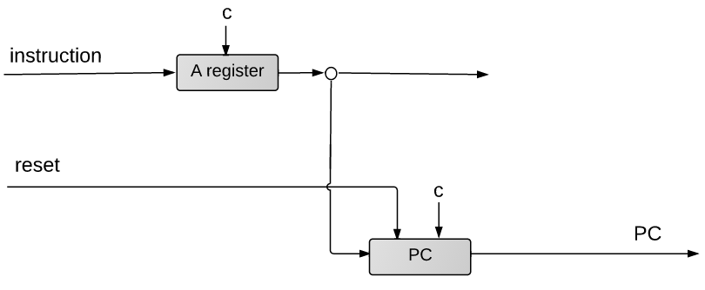
CPU implementation: Control
111accccccdddjjj
16
1
load
zr
ng
pc
16
...
address of next instruction
PC (program counter) abstraction:
Outputs the address of the next instruction:
reset: PC ← 0
no jump: PC++
jump: if (condition) PC ← A // A contains the address of the
// jump destination
Notes:
The bottom line of this whole apparatus is the address of the next instruction
Assumption: if the j-bits code a goto directive, then we assume that the A register was previously set to the goto address

Slide 66
CPU implementation: Control
111accccccdddjjj
16
load
ng
1
load
zr
pc
16
...
PC (program counter) implementation:
if (reset == 1) PC ← 0 // reset
else
if ( J(jump bits, zr, ng) == 1) PC ← A // jump
else PC++ // next instruction
address of next instruction
Notes:
The bottom line of this whole apparatus is the address of the next instruction
Assumption: if the j-bits code a goto directive, then we assume that the A register was previously set to the goto address

Slide 67
CPU implementation
pc
Executes the current instruction
Figures out which instruction to execute next.
Notes:
Which instruction should be executed next?

Slide 68
Chapter 5: Computer Architecture
Basic architecture
Fetch-Execute cycle
The Hack CPU
Input / output
Memory
Computer
Project 5: Chips
Project 5: Guidelines

Slide 69
Hack computer
Instruction Memory
CPU
Data Memory
Data
program
instruc-
tion
D register
write
read
Hello, world
A register
ALU
address
address
PC
screen memory map
keyboard mem. map
I/O devices
Screen (black and white)
Keyboard (regular)

Slide 70
Screen
Screen memory map
Physical screen
0
1
2
3
4
5
6
7
8
...
511
0
1111010100000000
refresh
0
...
Screen
1
0000000000000000
1
...
. . .
...
...
31
0000000000000001
32
0000101000000000
33
0000000000000000
. . .
63
0000000000000000
. . .
255
...
8159
1011010100000000
8160
0000000000000000
. . .
8191
0000000000000000

Slide 71
Screen
load
Physical screen
Screen
0
1
2
3
4
5
6
7
8
...
511
0
1111010100000000
refresh
0
...
Screen
1
0000000000000000
1
...
in
. . .
...
...
31
0000000000000001
32
0000101000000000
16
33
0000000000000000
out
. . .
63
0000000000000000
address
16
. . .
255
...
13
8159
1011010100000000
8160
0000000000000000
. . .
/** Memory of 8K 16-bit registers
with a display-unit side effect. */
CHIP Screen {
IN address[13], in[16], load;
OUT out[16];
BUILTIN Screen;
CLOCKED in, load;
}
8191
0000000000000000
The screen memory map is implemented as an 8K memory chip named Screen

Slide 72
Hack computer
Instruction Memory
CPU
Data Memory
Data
program
instruc-
tion
D register
write
read
Hello, world
A register
ALU
address
address
PC
screen memory map
keyboard mem. map
I/O devices
Screen (black and white)
Keyboard (regular)

Slide 73
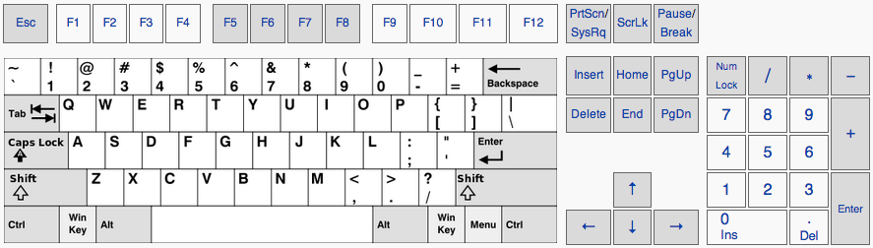
Keyboard
Keyboard
out
0000000000000000
16
refresh

Slide 74
Keyboard
Keyboard
out
0000000000000000
k
0000000001001011
16
refresh
code('k') = 75

Slide 75
Keyboard
Keyboard
out
0000000000000000
16
refresh
The keyboard memory map is implemented as a 16-bit memory register named Keyboard
/** 16-bit register that outputs the character code of the currently pressed keyboard key, or 0 if no key is pressed */
CHIP Keyboard {
OUT
out[16];
BUILTIN Keyboard;
}

Slide 76
The Hack character set
key | code
(space) | 32
! | 33
“ | 34
# | 35
$ | 36
% | 37
& | 38
‘ | 39
( | 40
) | 41
* | 42
+ | 43
, | 44
- | 45
. | 46
/ | 47
key | code
0 | 48
1 | 49
… | …
9 | 57
key | code
A | 65
B | 66
C | …
… | …
Z | 90
key | code
a | 97
b | 98
c | 99
… | …
z | 122
key | code
newline | 128
backspace | 129
left arrow | 130
up arrow | 131
right arrow | 132
down arrow | 133
home | 134
end | 135
Page up | 136
Page down | 137
insert | 138
delete | 139
esc | 140
f1 | 141
. . . | . . .
f12 | 152
: | 58
; | 59
< | 60
= | 61
> | 62
? | 63
@ | 64
[ | 91
/ | 92
] | 93
^ | 94
_ | 95
` | 96
{ | 123
| | 124
} | 125
~ | 126
(Subset of Unicode)

Slide 77
Hack computer
Instruction Memory
CPU
Data Memory
program
instruc-
tion
D register
write
read
Hello, world
A register
ALU
address
address
PC
screen memory map
keyboard mem. map
I/O devices
Screen (black and white)
Keyboard (regular)
More I/O devices can be added, as needed
Each requiring a memory map, and an interaction contract
Managed jointly by the hardware and the OS.

Slide 78
Chapter 5: Computer Architecture
Basic architecture
Fetch-Execute cycle
The Hack CPU
Input / output
Memory
Computer
Project 5: Chips
Project 5: Guidelines

Slide 79
Chapter 5: Computer Architecture
Basic architecture
Fetch-Execute cycle
The Hack CPU
Input / output
Memory
Computer
Project 5: Chips
Project 5: Guidelines

Slide 80
Memory
Overview
Intro
Computer architecture
The Hack CPU
Input / output
Memory
CPU
Symbolic programming
Control
Variables
Labels
Instruction Memory
Data Memory
Data
program
instruc-
tion
D register
write
A register
ALU
read
Hello, world
address
address
PC

Slide 81
Memory: Abstraction
load
Memory
0
Reading register i:
address ← i
Probe out
1
in
2
...
16
out
address
16
Setting register i to v:
in ← v
address ← i
load ← 1
15
24576

Slide 82
Memory: Implementation
load
Memory
0
Reading register i:
address ← i
Probe out
in
RAM16K
data
16
out
address
16383
16
Setting register i to v:
in ← v
address ← i
load ← 1
16384
Screen
(8K)
15
screen memory map
24575
24576
Keyboard
keyboard memory map

Slide 83
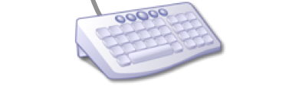
Memory: Implementation
load
in
built in project 3
Memory
16
0
out
RAM16K
address
16
in
16
RAM16K
14
out
Hello, world
16
in
address
16383
16
16384
Screen
out
15
Screen
(8K)
address
16
13
24575
built-in chip
24576
Keyboard
out
Keyboard
16
built-in chip
Memory architecture
An aggregate of three chip-parts: RAM16K, Screen, Keyboard
Single address space, 0 to 24576
Maps the address input onto the corresponding address input of the relevant chip-part.

Slide 84
Instruction memory
Overview
Intro
Computer architecture
The Hack CPU
Input / output
Memory
CPU
Symbolic programming
Control
Variables
Labels
Instruction Memory
Data Memory
Data
program
instruc-
tion
D register
write
A register
ALU
read
address
address
PC

Slide 85
Instruction memory
Overview
Intro
Computer architecture
The Hack CPU
Input / output
Memory
CPU
Symbolic programming
Control
Variables
Labels
Hack Program
ROM32K
Memory
0000000000001101
1110101001010101
0000000000000001
1110101001101011
0000001100110101
1110010111011111
.
.
.
1111001001100111
Data
program
instruc-
tion
D register
write
load
A register
ALU
read
address
address
PC
Hardware implementation
Plug-and-play ROM chip, named ROM32K
(pre-loaded with a program)
/** Read-Only memory (ROM),
acts as the Hack computer instruction memory. */
CHIP ROM32K {
IN address[15];
OUT out[16];
BUILTIN ROM32K;
}

Slide 86
Instruction memory
Overview
Intro
Computer architecture
The Hack CPU
Input / output
Memory
CPU
Symbolic programming
Control
Variables
Labels
Hack Program
ROM32K
Memory
0000000000001101
1110101001010101
0000000000000001
1110101001101011
0000001100110101
1110010111011111
.
.
.
1111001001100111
Data
program
instruc-
tion
D register
write
load
A register
ALU
read
address
address
PC
Hardware implementation
Plug-and-play ROM chip, named ROM32K
(pre-loaded with a program)
Hardware simulation
Programs are stored in text files;
The simulator software features a load-program service.

Slide 87
Chapter 5: Computer Architecture
Basic architecture
Fetch-Execute cycle
The Hack CPU
Input / output
Memory
Computer
Project 5: Chips
Project 5: Guidelines

Slide 88
Hack computer architecture
Overview
Intro
Computer architecture
The Hack CPU
Input / output
Memory
Symbolic programming
Control
Variables
Labels
ROM32K
CPU
Memory
Data
program
instruc-
tion
D register
write
A register
ALU
read
Hello, world
address
address
PC
Remaining challenge
Integrate into a single Computer chip

Slide 89

Computer abstraction
Assumption:
The computer is loaded with a program written in the Hack machine language
Computer
To execute the stored program:
set reset ← 1, then
set reset ← 0
reset
like pushing and releasing a button

Slide 90
Computer abstraction
Assumption:
The computer is loaded with a program written in the Hack machine language
Computer abstraction:
if (reset == 1), executes the first instruction in the stored program
if (reset == 0), executes the next instruction in the stored program
To execute the stored program:
set reset ← 1, then
set reset ← 0
reset
like pushing and releasing a button

Slide 91
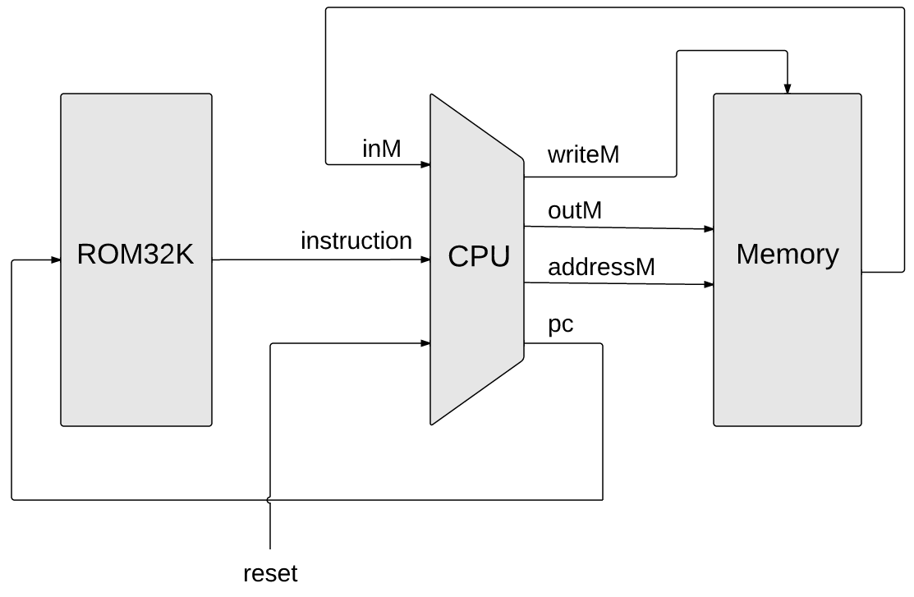
Computer implementation
reset

Slide 92
Computer implementation
reset

Slide 93
Computer implementation
reset

Slide 94
Computer implementation
reset

Slide 95
Computer implementation
reset

Slide 96
Computer implementation
Hello, world
reset

Slide 97

Computer implementation
Hello, world
reset

Slide 98
Computer implementation
Hello, world
“Make everything as simple as possible, but no simpler.”
– Albert Einstein

Slide 99
Chapter 5: Computer Architecture
Basic architecture
Fetch-Execute cycle
The Hack CPU
Input / output
Memory
Computer
Project 5: Chips
Project 5: Guidelines

Slide 100
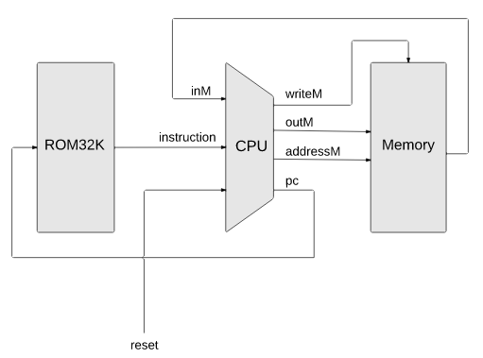
Hack computer
Computer
Hello, world

Slide 101
Hack computer
Hello, world

Slide 102
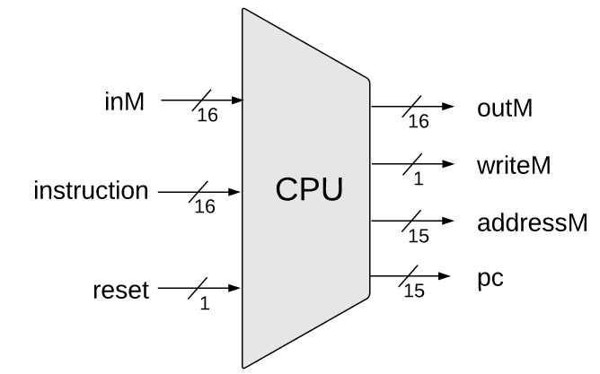
CPU
/** Central Processing unit.
Executes instructions written in Hack machine language.
CHIP CPU {
Notes:
Use built-in chip parts
It’s a very lean ALU, consisting of 2 registers, named D and A, a program counter, an ALU, and few more trivial gates.

Slide 103
CPU
/** Central Processing unit.
Executes instructions written in Hack machine language.
CHIP CPU {
IN
inM[16], // Value of M (RAM[A])
instruction[16], // Instruction to execute
reset; // Signals whether to execute the first instruction
// (reset==1) or next instruction (reset == 0)
OUT
outM[16] // Value to write to the selected RAM register
writeM, // Write to the RAM?
addressM[15], // Address of the selected RAM register
pc[15]; // Address of the next instruction
PARTS:
// Put you code here:
}
Notes:
Use built-in chip parts
It’s a very lean ALU, consisting of 2 registers, named D and A, a program counter, an ALU, and few more trivial gates.

Slide 104
CPU implementation
Chip parts:
Built in project 1 and project 2
Mux16
ALU
And, Or, Not ...
ARegister
DRegister
PC
Built in project 3
ARegister and Dregister are built-in Register chips
Notes:
Use built-in chip parts
It’s a very lean ALU, consisting of 2 registers, named D and A, a program counter, an ALU, and few more trivial gates.

Slide 105
CPU implementation
1110011111010111
Implementation
Use HDL to route instruction bits to chip-parts
Use gate logic to compute the address of the next instruction
Tips
No need for “helper chips”
Use logic gates and HDL for implementing everything.
Notes:
Use built-in chip parts
It’s a very lean ALU, consisting of 2 registers, named D and A, a program counter, an ALU, and few more trivial gates.

Slide 106
Computer
Hello, world

Slide 107
Memory
load
Memory.hdl
Memory
/** Complete address space of the computer’s data memory,
including RAM and memory mapped I/O.
Outputs the value of the memory location specified by address.
If (load==1), the in value is loaded into the memory location
specified by address.
0
in
16
RAM16K
out
address
16383
16
16384
Screen
(8K memory map)
15
24575
24576
Keyboard

Slide 108
Memory
load
Memory.hdl
Memory
/** Complete address space of the computer’s data memory,
including RAM and memory mapped I/O.
Outputs the value of the memory location specified by address.
If (load==1), the in value is loaded into the memory location
specified by address.
Address space rules:
Only the upper 16K+8K+1 words of the memory are used.
Access to address 0 to 16383 results in accessing the RAM;
Access to address 16384 to 24575 results in accessing
the Screen memory map;
Access to address 24576 results in accessing the Keyboard
memory map.
*/
CHIP Memory {
IN address[15], in[16], load;
OUT out[16];
PARTS:
// Put your code here.
}
0
in
16
RAM16K
out
address
16383
16
16384
Screen
(8K memory map)
15
24575
24576
Keyboard

Slide 109
Memory implementation
load
/** Memory of 16K 16-bit registers */
CHIP RAM16K {
IN
address[14], in[16], load;
OUT
out[16];
BUILTIN RAM16K;
CLOCKED in, load;
}
built in project 3
Memory
0
in
16
RAM16K
/** Memory of 8K 16-bit registers
with a display unit side effect. */
CHIP Screen {
IN
address[13], in[16], load;
OUT
out[16];
BUILTIN Screen;
CLOCKED in, load;
}
out
address
16383
16
16384
Screen
(8K memory map)
15
24575
24576
Keyboard
/** 16-bit register with a
keyboard input side effect */
CHIP Keyboard {
OUT
out[16];
BUILTIN Keyboard;
}
Implementation tip:
Use logic gates for mapping the address input on the corresponding address input of the relevant chip-part.

Slide 110
Computer
reset

Slide 111
Instruction memory
reset
ROM32K.hdl
/** Read-Only memory (ROM),
acting as the Hack computer instruction memory. */
CHIP ROM32K {
IN address[15];
OUT out[16];
BUILTIN ROM32K;
}

Slide 112
Computer
reset

Slide 113
Computer implementation
reset
Computer.hdl
/** The Hack computer, including CPU, RAM and ROM, loaded with a program.
When (reset==1), the computer executes the first instruction in the program;
When (reset==0), the computer executes the next instruction in the program. */
CHIP Computer {

Slide 114
Computer implementation
reset
Computer.hdl
/** The Hack computer, including CPU, RAM and ROM, loaded with a program.
When (reset==1), the computer executes the first instruction in the program;
When (reset==0), the computer executes the next instruction in the program. */
CHIP Computer {
IN reset;
PARTS:
// Put your code here.
}

Slide 115
Chapter 5: Computer Architecture
Basic architecture
Fetch-Execute cycle
The Hack CPU
Input / output
Memory
Computer
Project 5: Chips
Project 5: Guidelines

Slide 116
Project 5
Build three chips:
Memory.hdl chip-parts: RAM16K, Screen, Keyboard
CPU.hdl chip-parts: ARgister, DRegister, PC, ALU, ...
Computer.hdl chip-parts: CPU, Memory, ROM32K
(All the chip-parts should be built-in chips, except for Memory and CPU)
Tools
Text editor
Hardware simulator

Slide 117
Testing the Computer chip
Testing logic:
Load Computer.hdl into the hardware simulator
Load a Hack program into the ROM32K chip-part
Run the clock enough cycles to execute the program
reset
Computer.hdl
/** The Hack computer, including CPU, RAM and ROM, loaded with a program.
* When (reset==1), the computer executes the first instruction in the program;
* When (reset==0), the computer executes the next instruction in the program. */
CHIP Computer {
IN reset;
PARTS:
// Put your code here.
}

Slide 118
Testing the Computer chip
Testing logic:
Load Computer.hdl into the hardware simulator
Load a Hack program into the ROM32K chip-part
Run the clock enough cycles to execute the program
Test programs
Add.hack: RAM[0] ← 2 + 3
Max.hack: RAM[2] ← max(RAM[0], RAM[1])
Rect.hack: Draws a rectangle of RAM[0] rows of 16 pixels each.

Slide 119
Testing the Computer chip
Testing logic:
Load Computer.hdl into the hardware simulator
Load a Hack program into the ROM32K chip-part
Run the clock enough cycles to execute the program
ComputerMax.tst
load Computer.hdl,
output-file ComputerMax.out,
compare-to ComputerMax.cmp,
output-list time reset ARegister[] DRegister[] PC[] RAM16K[0] RAM16K[1] RAM16K[2];
// Loads a Hack program (that executes R2 = max(R0,R1))
ROM32K load Max.hack,
Test programs
Add.hack: RAM[0] ← 2 + 3
Max.hack: RAM[2] ← max(RAM[0], RAM[1])
Rect.hack: Draws a rectangle of RAM[0] rows of 16 pixels each.

Slide 120
Testing the Computer chip
Testing logic:
Load Computer.hdl into the hardware simulator
Load a Hack program into the ROM32K chip-part
Run the clock enough cycles to execute the program
ComputerMax.tst
load Computer.hdl,
output-file ComputerMax.out,
compare-to ComputerMax.cmp,
output-list time reset ARegister[] DRegister[] PC[] RAM16K[0] RAM16K[1] RAM16K[2];
// Loads a Hack program (that executes R2 = max(R0,R1))
ROM32K load Max.hack,
// Test 1: computes max(3,5)
set RAM16K[0] 3,
set RAM16K[1] 5,
output;
repeat 14 {
tick, tock, output;
}
// Resets the PC
set reset 1,
tick, tock, output;
// Test 2: computes max(23456,12345)
set reset 0,
set RAM16K[0] 23456,
set RAM16K[1] 12345,
output;
repeat 14 {
tick, tock, output;
}
Test programs
Add.hack: RAM[0] ← 2 + 3
Max.hack: RAM[2] ← max(RAM[0], RAM[1])
Rect.hack: Draws a rectangle of RAM[0] rows of 16 pixels each.

Slide 121
Testing the Computer chip
Testing logic:
Load Computer.hdl into the hardware simulator
Load a Hack program into the ROM32K chip-part
Run the clock enough cycles to execute the program
Rect.hack output:
R0
Test programs
Add.hack: RAM[0] ← 2 + 3
Max.hack: RAM[2] ← max(RAM[0], RAM[1])
Rect.hack: Draws a rectangle of RAM[0] rows of 16 pixels each.
Test script
ComputerRect.tst
Inspect it, and understand the testing logic.

Slide 122
What’s next?
abstraction
p4
Writing low-level programs
machine language
Developing an assembler
This chapter
hardware platform
abstraction
Building a computer
computer
abstraction
Building chips
p5
ALU, RAM
abstraction
Building gates
p2
elementary logic gates
Nand
p3
p1

Slide 123
What’s next?
abstraction
p4
Writing low-level programs
machine language
Developing an assembler
p6
Next chapter
hardware platform
abstraction
Building a computer
computer
abstraction
Building chips
p5
ALU, RAM
abstraction
Building gates
p2
elementary logic gates
Nand
p3
p1

Slide 124
End note: Memory hierarchy
Memory
CPU
Separate chips, bits travel long distances
instructions, data
register
register
•
ALU
•
addresses, data
•
register
•
•
•
Challenges
Slow access time
Limited memory space
Notes:
Accessing a memory location is expensive
Need to supply a long address
Getting the memory contents into the CPU takes time

Slide 125
End note: Memory hierarchy
Memory
CPU
Cache
register
Mass Storage
register
•
ALU
•
•
•
•
register
•
•
•
•
Challenges
Slow access time
Limited memory space
Typical solutions
Cache memory
External storage

Slide 126
End note: Memory hierarchy
Memory
CPU
Cache
register
Mass Storage
register
•
ALU
•
•
•
•
register
•
•
•
•
Memory hierarchy:
more storage space, slower access time

Slide 127
End note: Memory hierarchy
Memory
CPU
Cache
register
Mass Storage
register
•
ALU
•
•
•
•
register
•
•
•
•
Mass storage and cache memory are possible extensions
The basic Hack computer is built without them.

